Slide 1
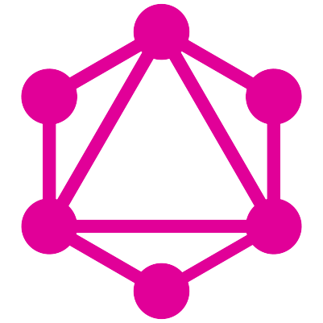
Hello “GraphQL”
<strike>Graph</strike>QL
Sai Nihar
SDE @ Pramati Technologies
“Loves Code, Poetry and Poetic Code”
Tweet me @nightraiser_
Notes:
After introduction, ask audience if they have heard, used graphql in production

Slide 2
Today
1) n`eti n`eti – What it is not
2) eti – What it is
3) Why should we give it a thought ?
4) Who are already using it ?
5) Demo
6) Q&A
Notes:
Neti neti is a sanskrit term
Demo – We are going to a node app and add graphql to it

Slide 3
n`eti n`eti
Its not related to any graph based concepts!

Slide 4
n`eti n`eti
Its not just front-end agnostic, but also is api based
Notes:
It is not just UI or API implmentations, we need to configure both our server and client to graphql specs to be able to use it

Slide 5
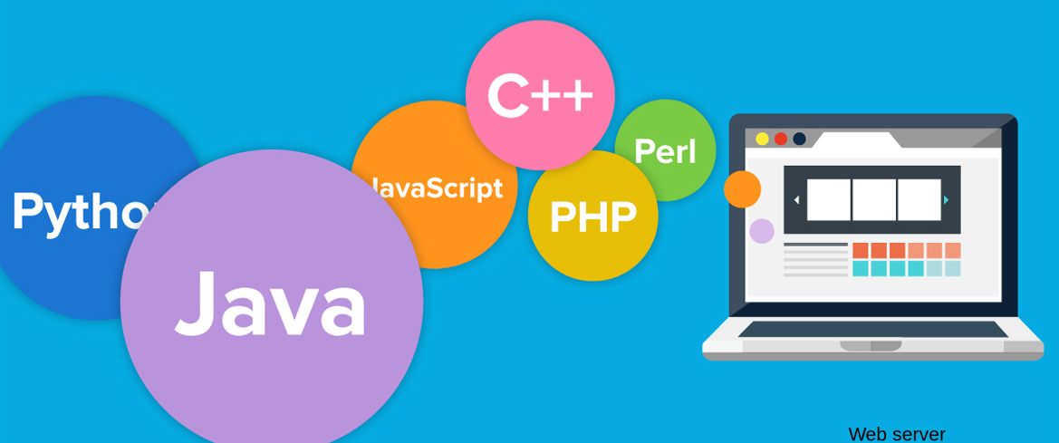
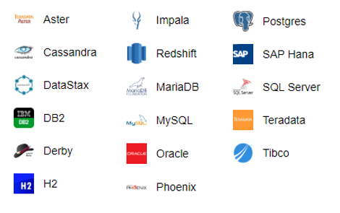
n`eti n`eti
It is not dependant of database and the scripting language
Notes:
It doesnt matter which scripting language one is using or from which database are we pulling the datafrom, that means we can include graphql in both schema and schemaless dbs

Slide 6
eti
Okay fine, now tell me what is it ?

Slide 7
eti
1) Its a API standard like REST, it was developed by Facebook, its uses HTTP verbs too.
2) “ A query language for your api ”
3) 3 point agenda
3.1) Describe your data
3.2) Ask for what you want
3.3) Get predictable results

Slide 8
How to Describe your data ?
1) We define the schema for the apis in a language called SDL (Schema Defination Language)
2) Very much similar to DTOs in java / .net or interfaces and types in typescript
3) Supported libraries to convert this scehma to any specific “type” in any language

Slide 9
How can I Ask for what I want ?
1) We define Queries, from which the client can request the data that it wants
2) We define Mutations, from which the client can request for updates in the data
3) We define Resolvers, to connect to services.

Slide 10
What are predictable results ?
1) There is a default support to some powerful developer tools like GraphiQL, Playground.
2) They provide us IDE like environment to execute the queries and mutations
3) Provides the schema documentation and intellicence

Slide 11
Anecdote

Slide 12
Why should we give it a thought ?
We can query a endpoint to send Certain specific information which is required. (Avoid Over loding an api)

Slide 13
Why should we give it a thought ?
We can use same endpoint for different purposes; home page, mobile home page, search etc

Slide 14
Why should we give it a thought ?
Auto generated documentation

Slide 15












Who are already using it ?
https://graphql.org/users/

Slide 16
Pre-Demo

Slide 17
CRUD in GraphQL
CRUD in GraphQL
Operation | REST | GraphQL
Read | GET | Query
Create | POST | Mutation
Update | PUT | Mutation
Delete | DELTE | Mutation

Slide 18
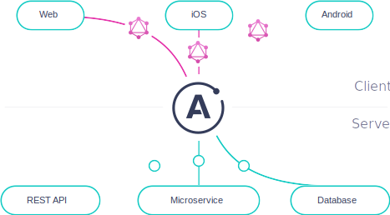
Apollo Client-Server
Notes:
Apollo provides us a client and server level apis which help us enable graphql on respective envs

Slide 19
Lets Query the GQL
Notes:
Ask audience if they can see the code

Slide 20
Q&A
queriesFromPeople(sort: “createdOn”, order: -1) {
Id
Query
}

